Slide 1
FLIGHT PRICE PREDICTION

Slide 2
CONTENTS
Problem Statement
Exploratory Data Analysis
Data Visualization

Slide 3
PROBLEM STATEMENT
Flight ticket prices can be something hard to guess, today we might see a price, check out the price of the same flight tomorrow, It will be a different story. We might have often heard travelers saying that flight ticket prices are so unpredictable. Here we collected the prices of flight tickets for various airlines.

Slide 4
EXPLORATORY DATA ANALYSIS
In flight price prediction dataset we have to predict the price for a flight. This dataset contains 2101 rows and 8 columns. For predicting the flight price first we have to importing the some important libraries. After importing the libraries we have to read and load the dataset.
After reading the dataset first we have to analyze it and after that we have to work on columns. We must check which columns are necessary for finding the target variable. Columns which are not much necessary for finding the target variables, we can drop that columns.
We also have to check the null values in columns. If any column has a null value we have to fill that null values according to the data types of the column. After filling all the null values data is ready for the further processing.

Slide 5
DATA VISUALIZATION

Slide 6
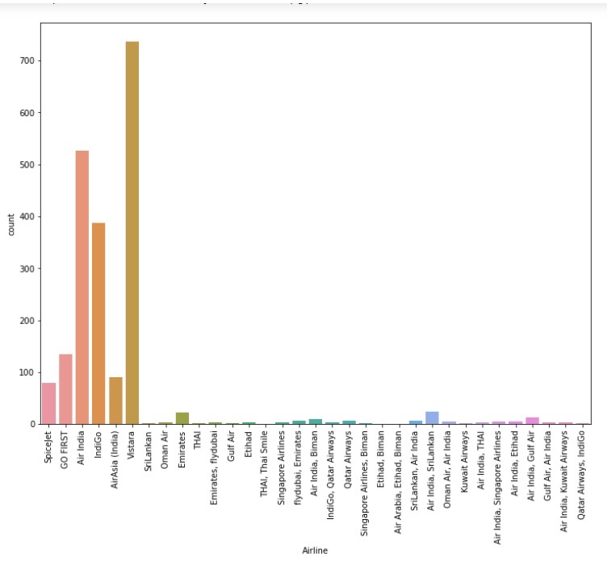
Diagram shows the bar plot of an airline.
Maximum people has selected the Vistara airlines over the other airlines.

Slide 7
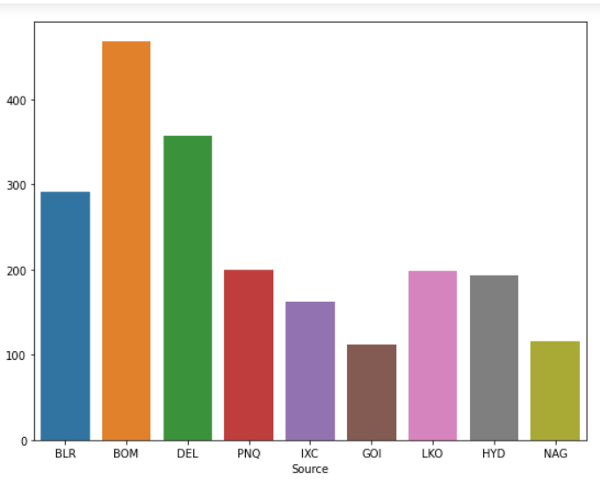
Given plot shows the bar plot of Source column.
This plot shows that from which city maximum flights are take off.
From plot we can say that maximum flights are take off the Mumbai and the minimum flights are take off from the Goa.

Slide 8
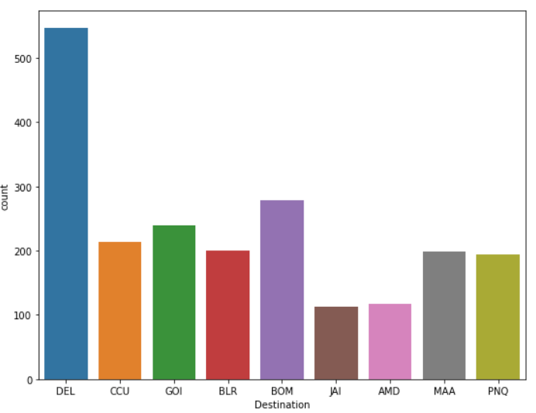
This plot shows the Destination for flights.
From given plot we can say that maximum flights are land in Delhi as compared to other cities.

Slide 9
DESCRIPTION
Description is the very important process in machine learning algorithm. Description of dataset is a statistical process. In description of the any dataset we have a count of dataset.
In Description process dataset is described column wise. After describing the dataset we have a mean of each column, standard deviation of each column, minimum value in the column and the maximum value in the column.
CORRELATION
Correlation means how one or more variable are related to each other. Sometimes variables are positively correlated or negatively correlated. Sometimes variables are highly correlated which results into multicollinearity. Correlation is also a statistical term in machine learning.

Slide 10
DATA CONVERSION
Data conversion is one of the important step in machine learning algorithm. For model testing we have to convert all the objective data into numerical format. After converting the data into numerical format we have to split data into x and y.
SPLITTING DATA INTO X AND Y
For calculating cross validation score, random state, r2 score and for model building we have to split dataset into x and y. Target column (Price) should be dropped from the dataset and assign to the variable y and remaining independent columns are assign to the variable x.
After splitting data into x and y we have to train and test the data.

Slide 11
TRAINING AND TESTIN PROCESS
After splitting the data into x and y we have to train and test the data.
Maximum 80 percent data is send for training and remaining data is for testing. x_train has (1575,8) data and y_train has 1575 data.
X_test has (525,8) data and y_test has 525 data.
r2 score
It is the proportion of the variation in the dependent variable that is predictable from the independent variable.

